Slide 1

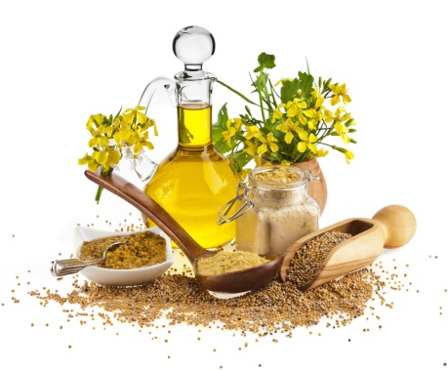
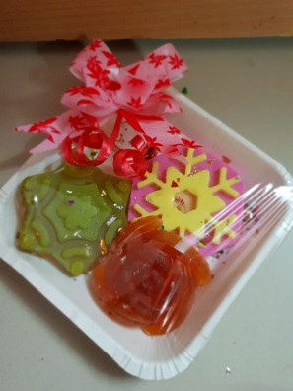
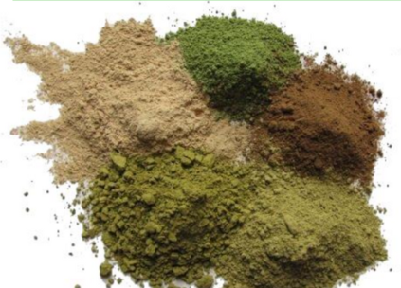
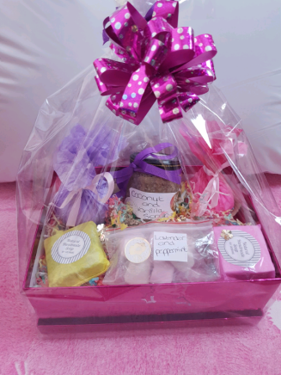
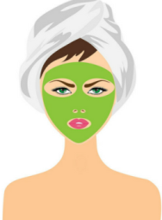
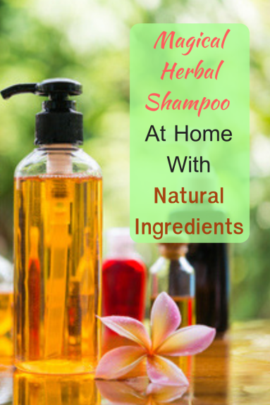
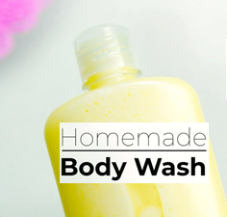
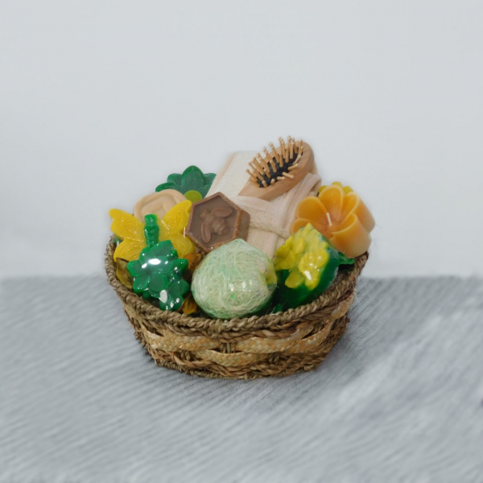
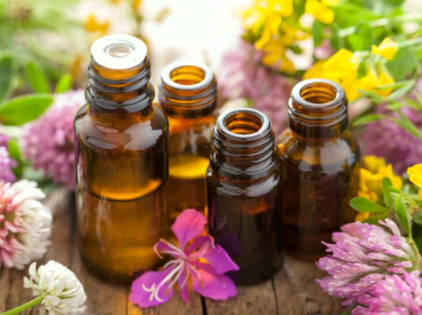
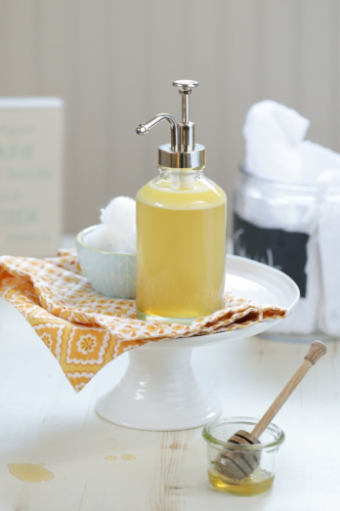
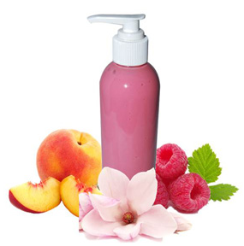
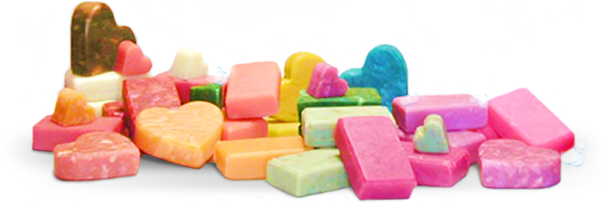
Naturista
Homemade and hand crafted products
All products are organic & herbal with natural ingredients. It exfoliates & revitalized the skin. These herbal cosmetics enhance your beauty, improves the texture of the skin and exfoliate it by making it glowing and smooth. Natural ingredients are safe and can be used according to skin types without any side effects.
Naturista
***For placing order or more details contact us on 7972235234/9326065352***
Sulphate & Parabeen free Shampoo
Face Packs & Face Scrubs
Medicated Oils
Soaps
Medicated Powders
Facial Serum
Gift Hampers
Lotions & creams

Slide 2
R
A
T
E
L
I
S
T
Naturista
***For placing order or more details contact us on 7972235234/9326065352***

Slide 3
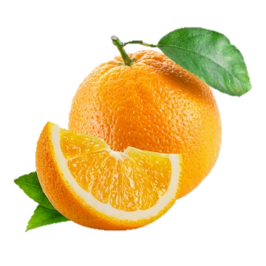
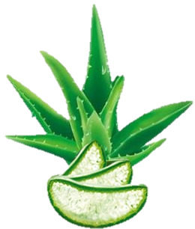
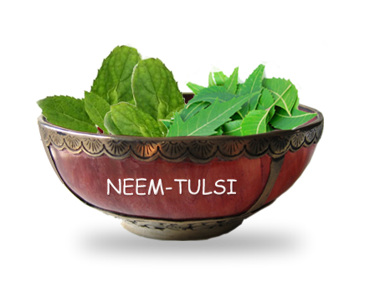
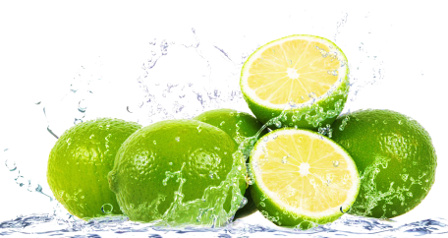
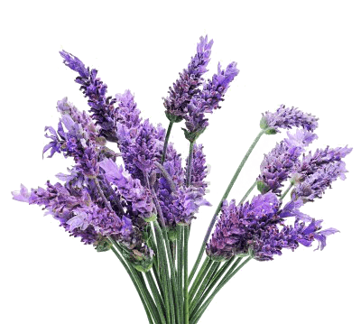
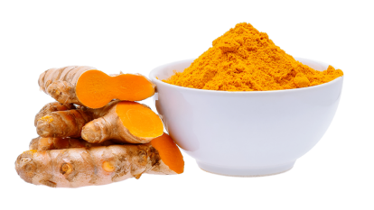
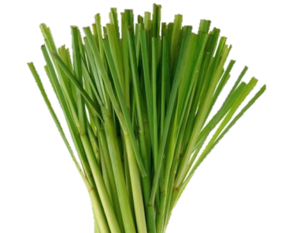
Orange Body Wash
Aloevera
Body Wash
Lemon Body Wash
Neem & Tulsi
Face Wash
Sulphate & Parabeen free
Sulphate & Parabeen free
Sulphate & Parabeen free
Lavender
Body Wash
Sulphate & Parabeen free
Turmeric
Face Wash
Lemongrass
Body Wash
Sulphate & Parabeen free
Sulphate & Parabeen free
Sulphate & Parabeen free

Slide 4

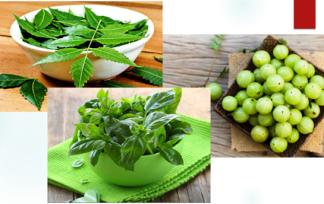
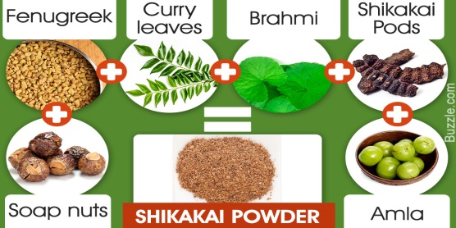

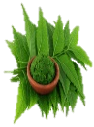
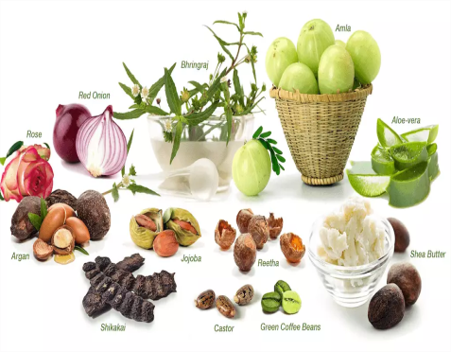
Orange fruit
Shampoo
*Oily hair
Aloevera
Shampoo
*Normal & dry hair
Anti Dandruff
Shampoo
Shampoo
Sulphate & Parabeen free
Sulphate & Parabeen free
Sulphate & Parabeen free
Shikakai
Shampoo
Lavender
Shampoo
Sulphate & Parabeen free
Hair oil
Naturista Logo
Complete hair care with natural ingredients.
Sulphate & Parabeen free
Sulphate & Parabeen free
Naturista
Sulphate & Parabeen free

